Slide 1
Retail Analysis

Slide 2
Content
Introduction
Insights
Conclusion
findings
Dashboard

Slide 3
Introduction
Retail analytics focuses on providing insights related to sales, inventory, customers, and other important aspects crucial for merchants’ decision-making process.
It is used to help make better choices, run businesses more efficiently, and deliver improved customer service analytics.

Slide 4
Agenda
To show market insight of company app
To analyse the variation between 2 year
To review Key activities
To evaluate financial performance

Slide 5
dASHBOARD

Slide 6
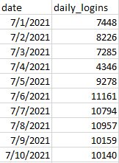
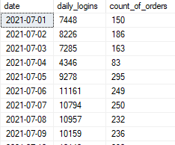
Findings
SQL query used to make dataset named “daily logins” which contains the number of logins on a daily basis
Daily trend of logins and trend of conversion rate

Slide 7
Different KPIs to measure the performance of our app
Growth between 2 years
Conversion rate
Frequency of Login
Rejection rate
Increase in Login frequency
Increase in Revenue
Increase in Rejection rate
Increase in shipping rate

Slide 8
Top-selling products in each of the two years
YEAR | PRODUCT ID | COUNT OF PRODUCT
2021 | 10235 | 1045
2022 | 12547 | 1572

Slide 9
How login frequency affect the number of orders made?
year | Login count | Total order
2021 | 271240 | 6261
2022 | 395117 | 7414

Slide 10
Insights
Login behavior of clients is directly proportional to order generated
Top/Bottom selling products of the company
Ratio of order placed to order canceled per year
Total revenue generated per year
Ratio of conversion of orders depends upon daily logins

Slide 11
CONCLUSION
Order canceled in 2022<2021
Client activity in 2022>2021
Revenue generated in 2022>2021
Client count in 2022>2021
Frequency of client login 2022>2021

Slide 12
THANKYOU

